Slide 1
Chapter Objective
Upon completion of this chapter, you will be able to:
Describe Backup/Recovery considerations
Describe Backup/Recovery operations
Describe Backup topologies
Describe backup technologies

Slide 2




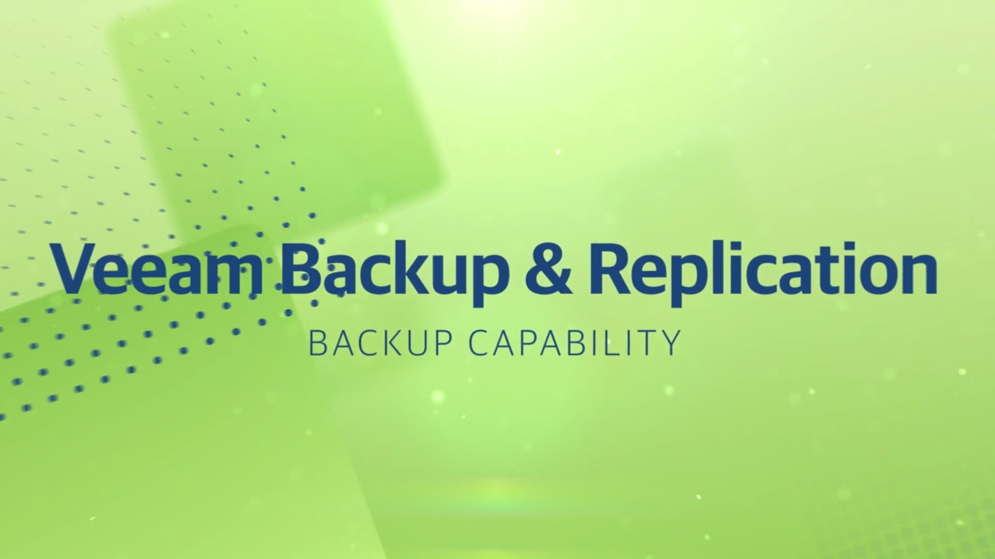

Slide 3
Lesson: Backup/Recovery Overview
Upon completion of this lesson, you be able to:
Define Backup and backup consideration
Describe purposes of backup
Explain backup granularity and restore
List backup methods
Describe backup/recovery process and operation

Slide 4
What is a Backup?
Backup is an additional copy of data that can be used for restore and recovery purposes
The Backup copy is used when the primary copy is lost or corrupted
This Backup copy can be created by:
Simply coping data (there can be one or more copies)
Mirroring data (the copy is always updated with whatever is written to the primary copy)

Slide 5
It’s All About Recovery
Businesses back up their data to enable its recovery in case of potential loss
Businesses also back up their data to comply with regulatory requirements
Backup purposes:
Disaster Recovery
Restores production data to an operational state after disaster
Operational
Restore data in the event of data loss or logical corruptions that may occur during routine processing
Archival
Preserve transaction records, email, and other business work products for regulatory compliance

Slide 6

Backup/Recovery Considerations
Customer business needs determine:
  What are the restore requirements – RPO & RTO?
  Where and when will the restores occur?
  What are the most frequent restore requests?
  Which data needs to be backed up?
  How frequently should data be backed up?
    hourly, daily, weekly, monthly
  How long will it take to backup?
  How many copies to create?
  How long to retain backup copies?

Slide 7
Other Considerations: Data
Location
Heterogeneous platform
Local and remote
Number and size of files
Consider compression ratio
Example:
10 files of 1MB size Vs 10000 files of 1KB size

Slide 8
Backup Granularity
Full Backup
Su
Su
Su
Su
Su
Cumulative (Differential) Backup
Su
M
T
W
T
F
S
Su
M
T
W
T
F
S
Su
M
T
W
T
F
S
Su
M
T
W
T
F
S
Su
Incremental Backup
Su
M
T
W
T
F
S
Su
M
T
W
T
F
S
Su
M
T
W
T
F
S
Su
M
T
W
T
F
S
Su
Amount of data backup

Slide 9
Restoring from Incremental Backup
Monday
Tuesday
Wednesday
Thursday
Friday
Files 1, 2, 3
File 4
Updated File 3
File 5
Files 1, 2, 3, 4, 5
Full Backup
Incremental
Incremental
Incremental
Production
Key Features
  Files that have changed since the last backup are backed up
  Fewest amount of files to be backed up, therefore faster backup and less storage space
  Longer restore because last full and all subsequent incremental backups must be applied

Slide 10
Restoring from Cumulative Backup
Monday
Tuesday
Wednesday
Thursday
Friday
Files 1, 2, 3
File 4
Files 4, 5
Files 4, 5, 6
Files 1, 2, 3, 4, 5, 6
Full Backup
Cumulative
Cumulative
Cumulative
Production
Key Features
  More files to be backed up, therefore it takes more time to backup
  and uses more storage space
  Much faster restore because only the last full and the last cumulative
  backup must be applied

Slide 11
Backup Methods
Cold or offline
Hot or online
Open file
Retry
Open File Agents
Point in Time (PIT) replica
Backup file metadata for consistency
Bare metal recovery

Slide 12
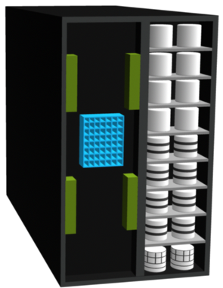
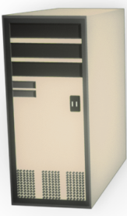
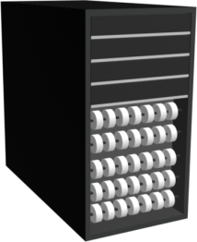
Backup Architecture and Process
Backup client
  Sends backup data to backup server or storage node
Backup server
  Manages backup operations and maintains backup catalog
Storage node
  Responsible for writing data to backup device
Metadata Catalog
Backup Data
Storage Array
Backup Data
Application Server/
Backup Client
Backup Server/
Storage Node
Tape Library

Slide 13

Backup Operation
Application Server and Backup Clients
1
Start of scheduled backup process
2
Backup server retrieves backup related
information from backup catalog
3a
Backup server instructs storage node to
load backup media in backup device
3b
Backup server instructs backup clients to
send its metadata to the backup server
and data to be backed up to storage node
3b
4
4
Backup clients send data to storage node
5
Storage node sends data to backup device
1
3a
5
6
Storage node sends media information to
backup server
2
7
6
7
Backup server update catalog and records
the status
Backup Server
Storage Node
Backup Device

Slide 14
Restore Operation
Application Server and Backup Clients
1
Backup server scans backup catalog
to identify data to be restore and the
client that will receive data
2
Backup server instructs storage node
to load backup media in backup device
3
Data is then read and send to backup
client
4
Storage node sends restore metadata
3
to backup server
5
Backup server updates catalog
1
2
3
5
4
Backup Server
Storage Node
Backup Device

Slide 15
Lesson Summary
Key points covered in this lesson:
Purposes for Backup
Considerations for backup and recovery
Backup granularity
Full, Cumulative, Incremental
Backup methods
Backup/recovery process and operation

Slide 16
Lesson: Backup/Recovery Topologies & Technologies
Upon completion of this lesson, you be able to:
Describe backup topologies
Direct backup
LAN and LAN free backup
Mixed backup
Detail backup in NAS environment
Describe backup technologies
Backup to tape
Backup to disk
Backup to virtual tape

Slide 17
Backup Topologies
There are 3 basic backup topologies:
  Direct Attached Based Backup
  LAN Based Backup
  SAN Based Backup
  Mixed backup

Slide 18

Direct Attached Backups
Metadata
Data
LAN
Backup Server
Application Server
and Backup Client
and Storage Node
Backup Device

Slide 19
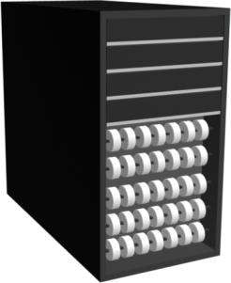
LAN Based Backups
Application Server
and Backup Client
Backup Server
Metadata
LAN
Data
Storage Node
Backup Device

Slide 20
SAN Based Backups (LAN Free)
LAN
FC SAN
Metadata
Data
Backup Server
Application Server
and Backup Client
Backup Device
Storage Node

Slide 21

Mixed Backup
Application Server
and Backup Client
Metadata
LAN
FC SAN
Metadata
Data
Backup Server
Application Server
and Backup Client
Backup Device
Storage Node

Slide 22


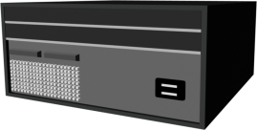

Backup in NAS Environment – Server Based
Storage
LAN
FC SAN
NAS Head
Application Server
(Backup Client)
Backup Device
Backup Request
Data
Metadata
Backup Server/ Storage Node

Slide 23
Backup in NAS Environment – Serverless
Storage
LAN
FC SAN
NAS Head
Application Server
(Backup Client)
Backup Device
Backup Request
Data
Metadata
Backup Server /
Storage Node

Slide 24

Backup in NAS Environment – NDMP 2-way
Storage
LAN
FC SAN
NAS Head
Application Server
(Backup Client)
Backup Device
Backup Request
Data
Metadata
Backup Server

Slide 25
Backing up a NAS Device – NDMP 3-way
NAS Head
FC SAN
LAN
Storage
LAN
Application Server
(Backup Client)
FC SAN
NAS Head
Backup Device
Backup Request
Data
Metadata
Backup Server

Slide 26
Backup Technology options
Backup to Tape
  Physical tape library
Backup to Disk
Backup to virtual tape
  Virtual tape library

Slide 27
Backup to Tape
Traditional destination for backup
Low cost option
Sequential / Linear Access
Multiple streaming
  Backup streams from multiple clients to a single backup device
Data from
Stream 1
Data from
Stream 2
Data from
Stream 3
Tape

Slide 28
Physical Tape Library

Slide 29
Tape Limitations
Reliability
  Restore performance
    Mount, load to ready, rewind, dismount times
Sequential Access
Cannot be accessed by multiple hosts simultaneously
Controlled environment for tape storage
Wear and tear of tape
Shipping/handling challenges
Tape management challenges

Slide 30
Backup to Disk
Ease of implementation
Fast access
More Reliable
Random Access
Multiple hosts access
Enhanced overall backup and recovery performance

Slide 31
Tape versus Disk – Restore Comparison
Disk
Backup / Restore
24
Minutes
Tape
Backup / Restore
108
Minutes
0
10
20
30
40
50
60
70
80
90
100
110
120
Recovery Time in Minutes*
*Total time from point of failure to return of service to e-mail users
Typical Scenario:
  800 users, 75 MB mailbox
  60 GB database
Source: EMC Engineering and EMC IT

Slide 32

Virtual Tape Library
Backup Server/
Storage Node
FC SAN
LAN
Virtual Tape Library Appliance
Emulation Engine
Storage (LUNs)
Backup Clients

Slide 33
Tape Versus Disk Versus Virtual Tape
 | Tape | Disk-Aware Backup-to-Disk | Virtual Tape
Offsite Capabilities | Yes | No | Yes
Reliability | No inherent protection methods | RAID, spare | RAID, spare
Performance | Subject to mechanical operations, load times | Faster single stream | Faster single stream
Use | Backup only | Multiple (backup/production) | Backup only

Slide 34
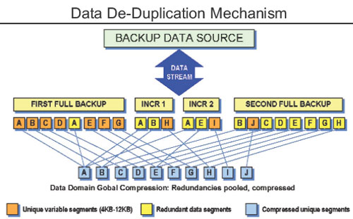
Data De-duplication
Data de-duplication refers to removal of redundant data. In the de-duplication process, a single copy of data is maintained along with the index of the original data, so that data can be easily retrieved when required. Other than saving disk storage space and reduction in hardware costs, (storage hardware, cooling, backup media, etc), another major benefit of data de-duplication is bandwidth optimization.
Notes:
No matter what kind of business are you in, your data is bound to grow. This makes you add to your storage space continually. However, at times multiple copies of the same data seem to occupy your storage pool. For instance, a presentation which talks about the products of your company might be stored by various users in various departments in your company, resulting in wastage of storage space. Adding to this is the fact that whenever you take the backup of your primary storage device, multiple copies of the same data get duplicated again on the backup storage, be it a tape or a disk based storage. You can do away with all this duplication with the help of data de-duplication technologies.
Data de-duplication refers to removal of redundant data. In the de-duplication process, a single copy of data is maintained along with the index of the original data, so that data can be easily retrieved when required. Other than saving disk storage space and reduction in hardware costs, (storage hardware, cooling, backup media, etc), another major benefit of data de-duplication is bandwidth optimization.
Data de-duplication can be deployed in two ways -source based and target based. The source based de-duplication is done before the backup i.e, at primary storage such as NAS, while in target method, de-duplication is done after the backup. However, in a target based method, de-duplication can also be during the backup, which is known as inline de-duplication. The benefit of in-line deduplication over post-process deduplication is that it requires less storage as data is not duplicated unlike post-process de-duplication.
Source based data de-duplication is usually deployed in environments such as, file-systems, remote branch office environments and virtualization environments. In remote backup scenario, the source based data de-duplication also means that there will be less data traveling through the WAN pipe, resulting in effective bandwidth utilization. Target based de-duplication is a good option where bandwidth is not an issue, such as SAN or LAN backup environments.
How it works?
Largely, there are three techniques used by data de-duplication vendors, file level, block level and byte level. File level de-duplication, also known as single instance stores (SIS), searches for identical files on the disk and eliminates identical ones. The biggest drawback of this method is that if the same file is present with two different names, it won't be eliminated. Block level de-duplication works at more granular level as compared to file level de-duplcation. Here data is broken down to blocks which can be any logical or fixed length blocks and the de-duplication solution looks for unique blocks (most solutions do this by calculating hash). When a unique block is stored, its identifier is created in the index. Now, whenever a repeated block comes across, instead of storing the entire block, a pointer to the existing block is placed in the index thus saving the storage space. Block level de-duplication offers various advantages over the file level de-duplication. The same file with two different names not removed by file based de-duplication will be easily removed in block level de-duplication. Also, if only a part of the file is modified, the modified part will be stored uniquely as compared to the entire data.
Byte level data de-duplication is mostly used in post-processing scenarios. Here, new data is compared at byte level with already existing data and only the changes are stored. Byte level de-duplication can deliver accurate backups. As byte by byte comparison is time consuming, which is the precise reason de-duplication is done after backup, but before data is finally written. However, the catch here is that, this requires extra disk space, to ensure there is enough space for de-duplication to be done while data is on hold. For block level de-duplication to work effectively, data needs to be broken into very small chunks, mostly around 8kb. The drawback here is, the smaller the block size, the more the entires in hash table, and handling the table in itself can become a challenge. Compare to this, byte level stores data in large segments, mostly around 100MB.
Benefits
In an enterprise, most redundant data comes from backing the same data again and again. Depending upon the environment and type de-duplication technology used. Vendors claim, enterprises can achieve de-duplication ratio of 50:1 in source based scenario, and 20:1 in target based scenario. However, before choosing a particular solution, it's important to find out which technologies will suit your current environment and what are your priorities. For instance, are you looking to cut down your WAN costs along with the storage costs? Also a target based de-duplication can come as an add-on to your existing data backup solution. However, for source based, you might need to deploy the solution from the scratch. Last but not the least, data de-duplication is also considered as a green technology as reduction in storage space also means less power consumption and reduction in carbon emission.

Slide 35
Lesson Summary
Key points covered in this lesson:
Backup topologies
Direct attached, LAN and SAN based backup
Backup in NAS environment
Backup to Tape
Backup to Disk
Backup to virtual tape
Comparison among tape, disk and virtual tape backup

Slide 36
Chapter Summary
Key points covered in this chapter:
Backup and Recovery considerations and process
Backup and Recovery operations
Common Backup and Recovery topologies
Backup technologies
Tape, disk, and virtual tape

Slide 37
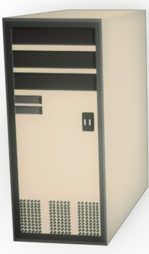
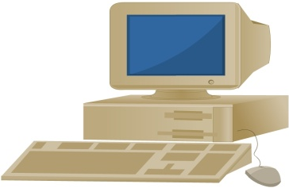
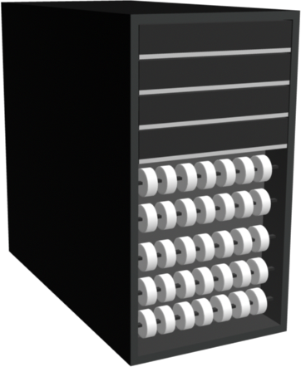
Data Tracking
& Management
Tracking Data
Data Source
Recovery
Data
Backup Device
Backup Data
Backup Data
Recovery
Data
Storage Node

Slide 38

BARE OS
Centos -8
Bare OS backup Server
CPU-2
Memory 2 GB
Disk 20GB
Centos -8
Bare OS backup Client
CPU-1
Memory 1 GB
Disk 20GB

Slide 39
Bacula with centos 7
Centos -7
Bacula backup Server
CPU-2
Memory 2 GB
Disk 20GB
Centos -7
Bacula backup Server
CPU-1
Memory 1 GB
Disk 20GB

Slide 40
Check Your Knowledge
What are three primary purposes for backup?
What are the three topologies that support backup operation?
Describe three major considerations of backup/recovery.
What are the advantages and disadvantages in tape and virtual tape backups?
What are the three levels of granularity found in Backups?
How backup is performed using virtual tape library?

